Slide 1
Why have wages of married females increased? by
Zvi Eckstein, Michael Keane and Osnat Lifshitz
Bar Ilan University, January 12, 2015
Preliminary Draft

Slide 2
Outline
Reconsider the married/non-married females and males dynamics in the labor market:
Data
Questions
Model
Preliminary results

Slide 3
Labor Market Data for Married, Divorced and Single
CPS Data, 22-65: 1962-2011

Slide 4
Employment Rates
Married Female Employment Increased
Non-Married Employment Fluctuates
Married Males 83% to 57% of population
Single Females
8% to 23% of population
Single Males 12% to 29% of population
Divorced Males 4.5% to 13% of population
Notes:
Stable employment rates for married females since 1997
Significant negative trend for non-married females/males since 2000
Stronger drop in recent recession 2008-11 for non-married females and males

Slide 5
Unemployment Rates
Single Males
Divorced Males
Divorced Females
Single Females
Married Females
Married Males
Notes:
1. Higher unemployment rates among non-married men. Large change in recent recession
2. Married and non-married unemployment for females are the same and same as married men.
3. Non-married respond more to recent recession.
4. Divorced and single males have the same response and level of UE that is different than married males.

Slide 6
Female Employment Rates by Cohort only Married Female Employment increases by cohort
Years 1962-2011. Proportion of women working 10+ weekly hours.
Notes:
Large cohort employment rise for married females all ages: recent convergence (1965-75)
Small and similar rise in employment rates for non-married by cohort:

Slide 7
Employment Rates of Divorced Females with Children by Cohort
Why does the pattern for divorced female with children is not as for married female?
Can the difference from married be explained by change in home production technology?
(Greenwood at el.)
Years 1962-2011. Proportion of women working 10+ weekly hours.

Slide 8
Male Employment Rates by Cohort
No Change by Cohort
Years 1962-2011. Proportion of men working 10+ weekly hours.
Notes:
Almost no change by cohorts for men – married and non-married.
Some decrease for both for 1965 men (more for non-married)

Slide 9
Breakdown of Married/ Non-Married Female by Level of Education
Married Women Become More Educated than Non-Married
SC Non Married
SC Married
CG Married
HSG Married
HSG Non Married
CG Non Married
PC Married
HSD Married
PC Non Married
Notes:
Rise in education of married women – mainly in CG and PC
Trend is still positive. More married women have higher education

Slide 10
Breakdown of Married/ Non-Married Men by Level of Education
Married Men Become More Educated than Non-Married
SC Non Married
HSG Non Married
SC Married
CG Married
HSG Married
CG Non Married
HSD Non Married
PC Married
HSD Married
PC Non Married
Notes:
Men education trends is the same as for females, recently. But all in advance.

Slide 11
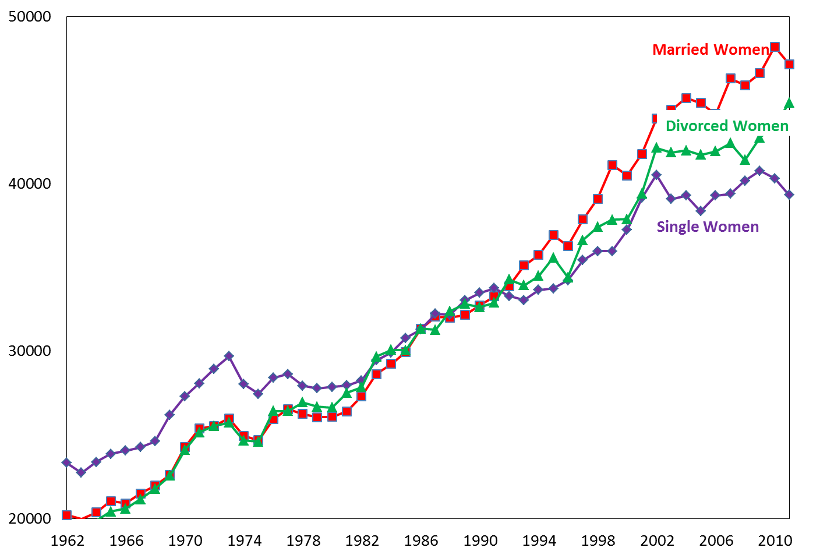
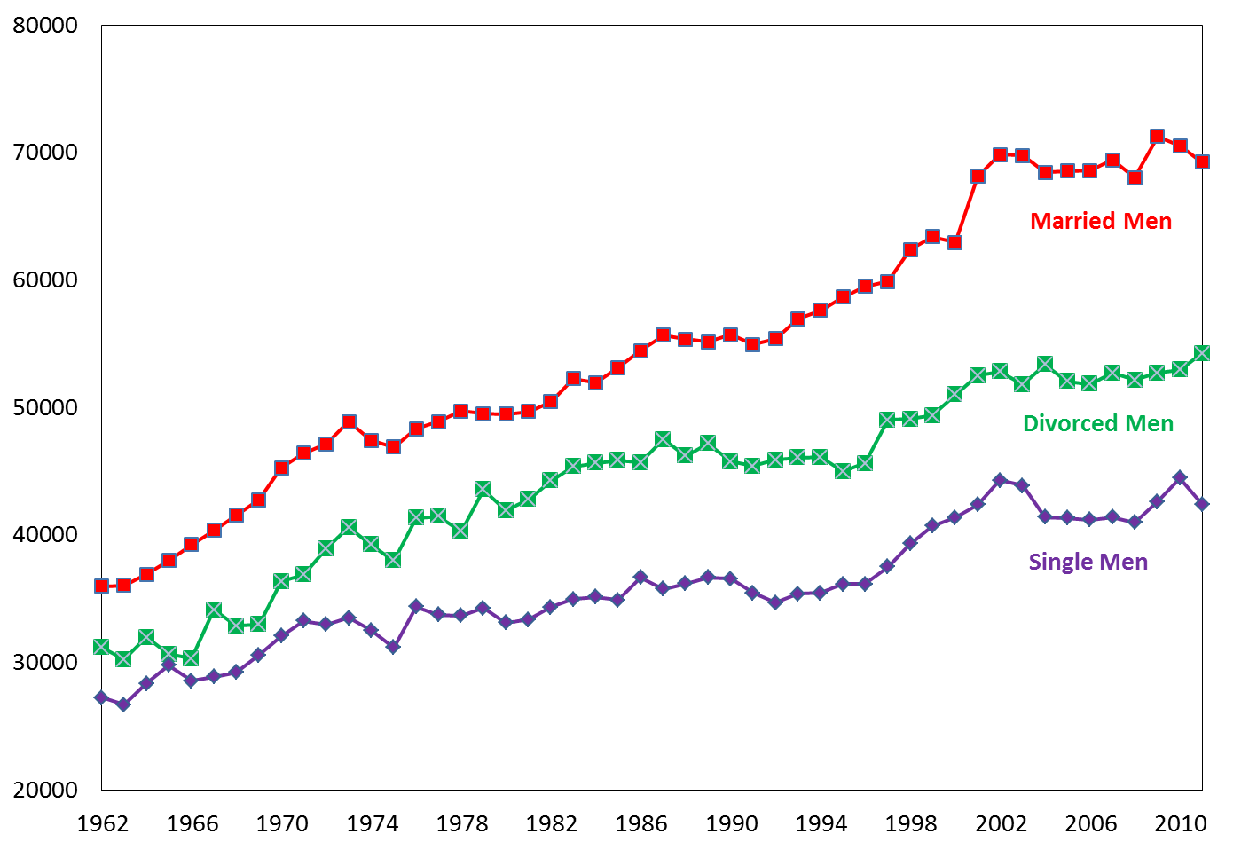
Annual Wages of Full-Time Workers: Married women become better
Women
Men
Annual Growth Rate 1980-2011:
Married 2%
Divorced 1.7%
Single 1.1%
Annual Growth Rate 1980-2011:
Married 1.1%
Divorced 0.9%
Single 0.8%
Ages 22-65. Full-time full-year workers with non-zero wages. 2006 Prices.
Notes:
Since 1992 married females wages are higher than that non-married.
Single females wages stay constant since 2002 – similar to single men
Females look more like men – but trend and levels are still different

Slide 12
Marriage Premium by Cohort
Marriage premium for males is decreasing and for females is increasing. Selection into marriage has changed
Men
Women
Caucasian, Ages 25-55
Notes:
Marriage premium for males is decreasing and for women is increasing. Selection into marriage has changed. Why?

Slide 13
Questions
Why does female marriage premium become positive?
Why do married females now earn more and are more educated than non-married?
Answer: Different selection into marriage over time: Why?
Account for:
  Change in marriage market opportunities
  Change in composition and return to education
  Change in cost of divorce
  Change in household production costs

Slide 14
Literature
Chiappori (1992, 1997)
Keane and Wolpin (1997, 2008)
Eckstein and Lifshitz (2011)
Mulligan and Rubinstein (2005)
Blau and Kahn (2007)
Greenwood and Seshardi (2005)
Fernandez and Wong (2011)
Notes:
Mulligan and Rubinstein (2005)
Blau and Kahn (2007) `Changes in the labor supply behavior of married women: 1980-2000.‘ - women's labor supply became less
responsive to their husbands' wages over time.
GREENWOOD and SESHADRI (2005): “Technological Progress and Economic Transformation,”
Fernandez and Wong (2011) `The disappearing gender gap: The impact of divorce, wages, and preferences on education choices and women's work.‘ - argue that the increase in the probability of divorce can explain a large proportion of the observed changes in female employment from the 1935 to the 1955 cohort.

Slide 15
The Model

Slide 16
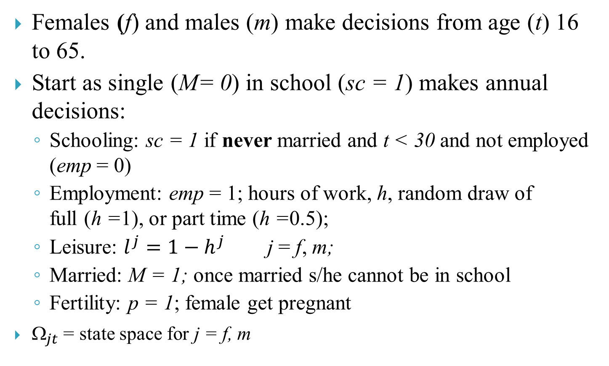
Basics
Females (f) and males (m) make decisions from age (t) 16 to 65.
Start as single (M= 0) in school (sc = 1) makes annual decisions:
  Schooling: sc = 1 if never married and t < 30 and not employed (emp = 0)
  Employment: emp = 1; hours of work, h, random draw of full (h =1), or part time (h =0.5);
  Leisure: $l_{}^{j}=1−h_{}^{j}$ j = f, m;
  Married: M = 1; once married s/he cannot be in school
  Fertility: p = 1; female get pregnant
$_{jt}$ = state space for j = f, m

Slide 17
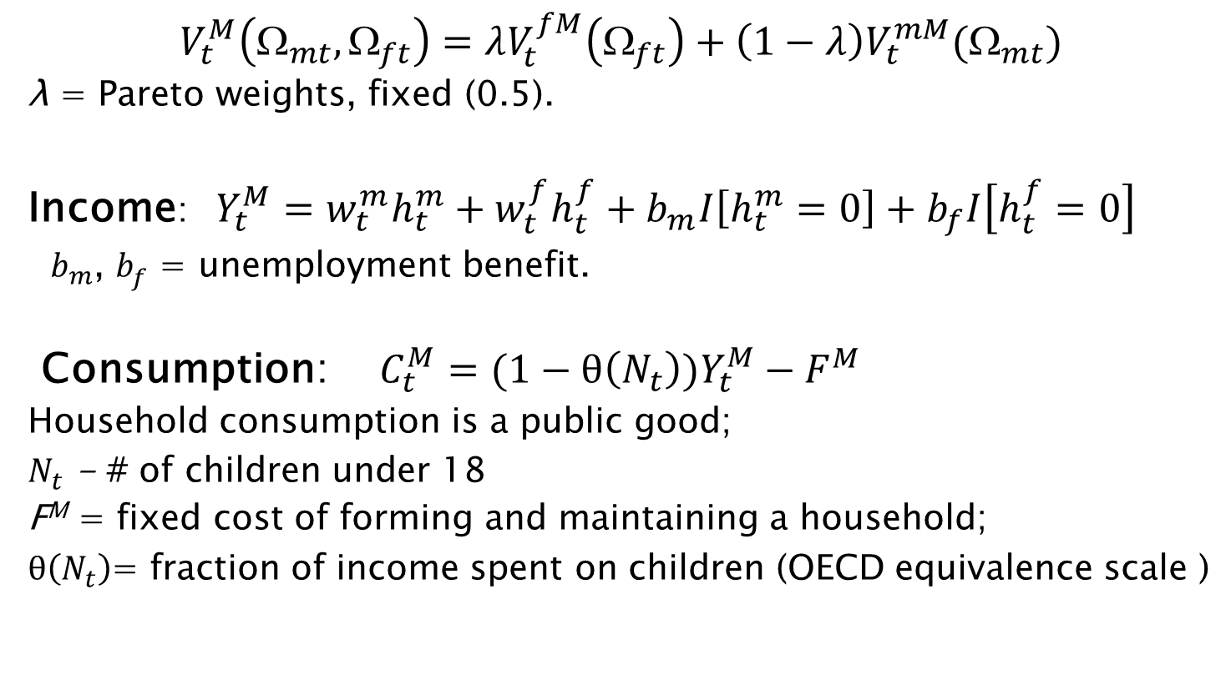
Value functions for married
$V_{t}^{M}\left(Ω_{mt},Ω_{ft}\right)=λV_{t}^{fM}\left(Ω_{ft}\right)+\left(1−λ\right)V_{t}^{mM}(Ω_{mt})$
λ = Pareto weights, fixed (0.5).
Income:$Y_{t}^{M}=w_{t}^{m}h_{t}^{m}+w_{t}^{f}h_{t}^{f}+b_{m}I\left[h_{t}^{m}=0\right]+b_{f}I\left[h_{t}^{f}=0\right]$
$b_{m}^{}$, $b_{f}^{}$ = unemployment benefit.
Consumption: $C_{t}^{M}=(1−θ\left(N_{t}\right))Y_{t}^{M}−F^{M}$
Household consumption is a public good;
$N_{t}$ - # of children under 18
F^{M} = fixed cost of forming and maintaining a household;
$θ\left(N_{t}\right)$= fraction of income spent on children (OECD equivalence scale )

Slide 18


Married person utility (cont.)
$$V_{t}^{jM}\left(Ω_{jt}\right)=\frac{1}{α}{\left({ψC}_{t}^{M}\right)}^{α}+L{\left(l_{t}^{j}\right)}^{}+θ_{t}^{}+π_{t}^{M}p_{t}+{A_{j}^{M}}^{}Q\left(l_{t}^{f},l_{t}^{m}, Y_{t}^{M},N_{t}\right)$$
$+δEV(Ω_{j,t+1})$
Where
L$\left(l_{t}^{j}\right)=\frac{β_{jt}}{γ}{\left(l_{t}^{j}\right)}^{γ}+μ_{jt}l_{t}^{j}$ - Value of Leisure
${ln⁡(μ}_{jt})=τ_{0j}{ln⁡(μ}_{jt−1})+τ_{1j}+τ_{2j}p_{t−1}+ε_{jt}^{l}l_{t}^{j} and ε_{jt}^{l}\sim iidN(0,σ_{ε}^{l}){}$
$ψ$ – couple’s OECD equivalent scale (0.85)
β_{jt} - tastes for leisure, depends on health( ), education (E_{jt}) and pregnancy (for females)
${ μ}_{jt}$- marginal utility of leisure that increases with a new born and then slowly converge to the steady state value of $τ_{1j}$ (ar(1)).

Slide 19

Married person utility (cont.)
$$V_{t}^{jM}\left(Ω_{jt}\right)=\frac{1}{α}{\left({ψC}_{t}^{M}\right)}^{α}+L{\left(l_{t}^{j}\right)}^{}+θ_{t}^{}+π_{t}^{M}p_{t}+A_{j}^{M}Q\left(l_{t}^{f},l_{t}^{m}, Y_{t}^{M},N_{t}\right)$$
$+δEV(Ω_{j,t+1})$
$θ_{t}^{}$ = utility from marriage
$π_{t}^{M}p_{t}$ = utility from pregnancy (p_{t}=1)
$A^{M}Q$= quality and quantity of children

Slide 20
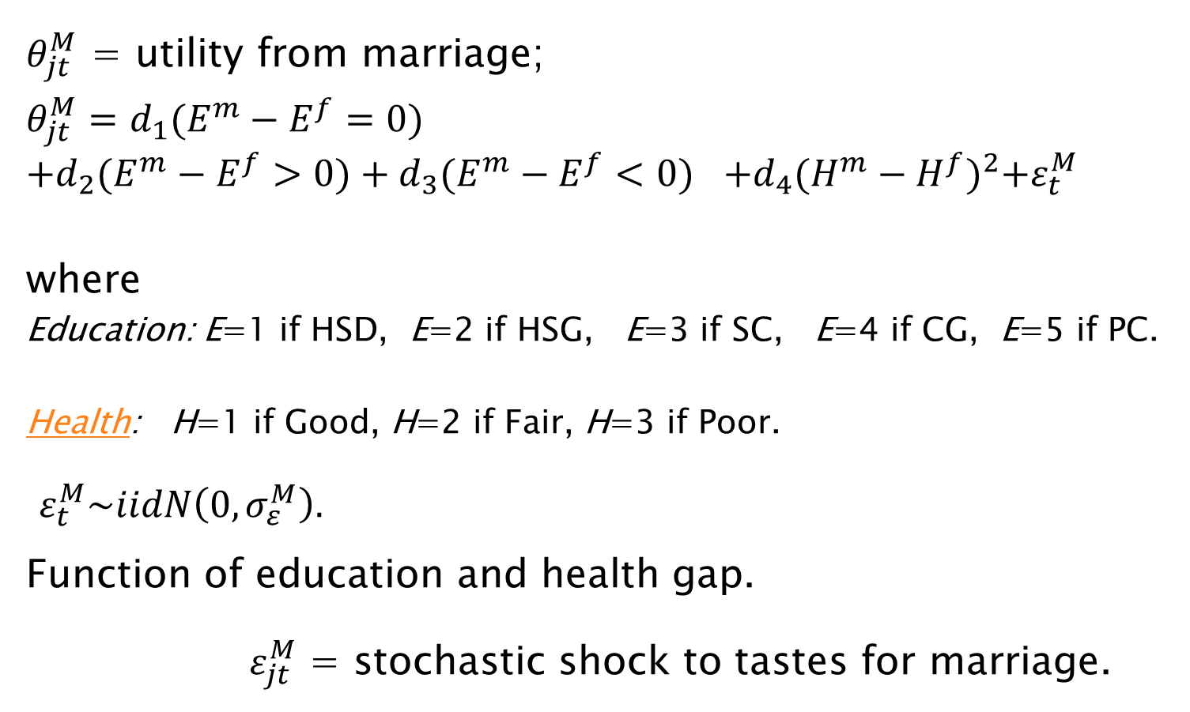
Married person utility (cont.)
$θ_{jt}^{M}$ = utility from marriage;
$$θ_{jt}^{M}=d_{1}{(E^{m}−E^{f}=0)}^{}$$
$$+d_{2}(E^{m}−E^{f}>0)+d_{3}{(E^{m}−E^{f}<0)}^{}+d_{4}{(H^{m}−H^{f})}^{2}+ε_{t}^{M}$$
where
Education: E=1 if HSD, E=2 if HSG, E=3 if SC, E=4 if CG, E=5 if PC.
Health: H=1 if Good, H=2 if Fair, H=3 if Poor.
$ε_{t}^{M}\sim iidN\left(0,σ_{ε}^{M}\right).$
Function of education and health gap.
$ε_{jt}^{M}$ = stochastic shock to tastes for marriage.

Slide 21
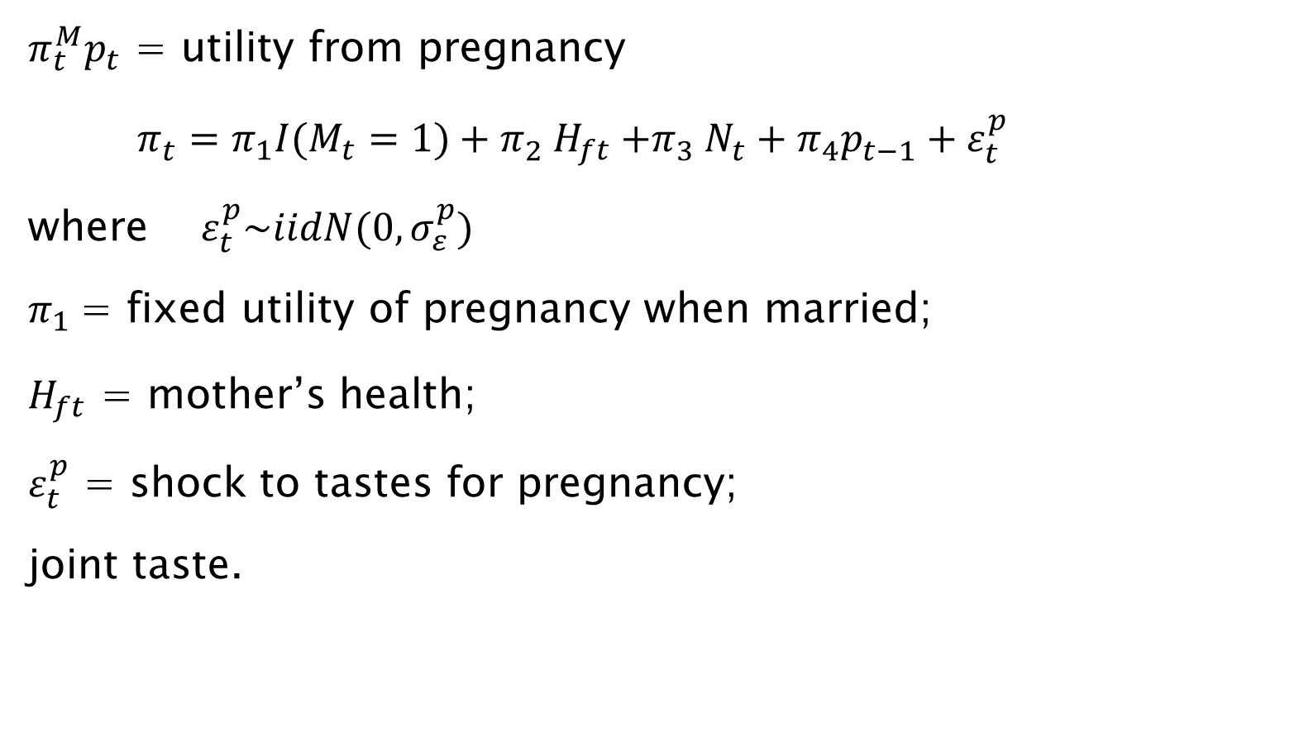
Married person utility (cont.)
$π_{t}^{M}p_{t}$ = utility from pregnancy
$π_{t}^{}=π_{1}I(M_{t}=1)+π_{2}^{} H_{ft}{+π}_{3}^{}N_{t}^{}+π_{4}^{}p_{t−1}^{}+ε_{t}^{p}$
where $ε_{t}^{p}\sim iidN(0,σ_{ε}^{p})$
$π_{1}$= fixed utility of pregnancy when married;
$H_{ft}$ = mother’s health;
$ε_{t}^{p}$ = shock to tastes for pregnancy;
joint taste.

Slide 22
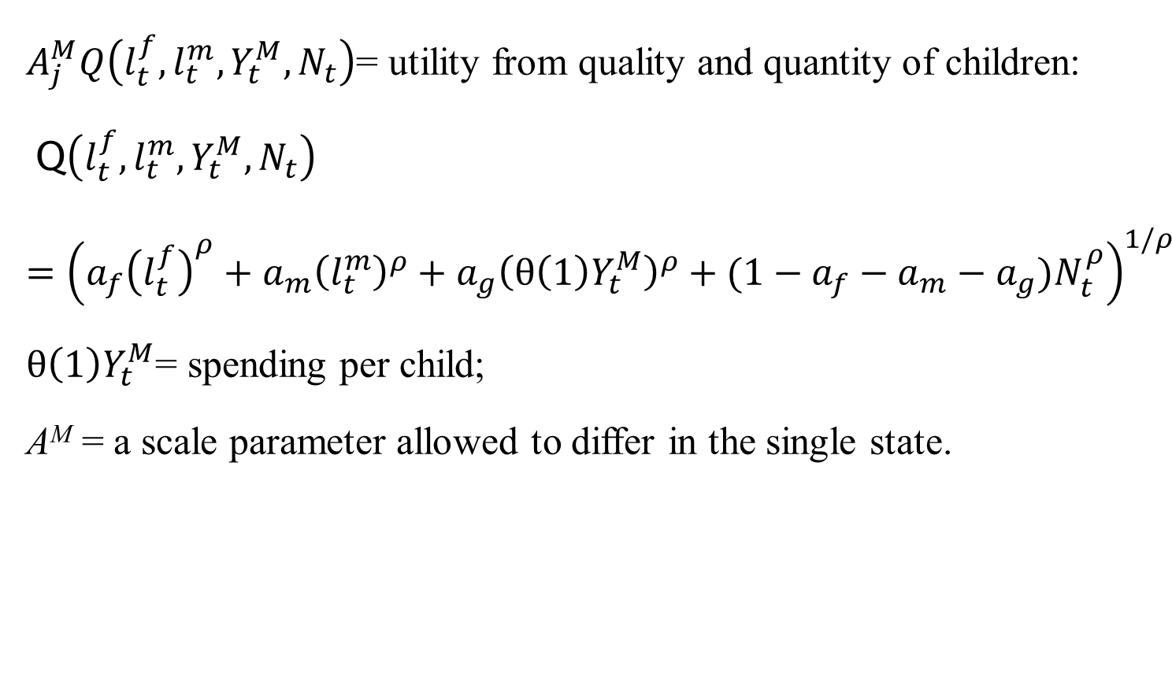
Married person utility (cont.)
$A_{j}^{M}Q\left(l_{t}^{f},l_{t}^{m}, Y_{t}^{M},N_{t}\right)$= utility from quality and quantity of children:
Q$\left(l_{t}^{f},l_{t}^{m}, Y_{t}^{M},N_{t}\right)={\left(a_{f}{\left(l_{t}^{f}\right)}^{ρ}+a_{m}{\left(l_{t}^{m}\right)}^{ρ}+a_{g}{\left(θ\left(1\right)Y_{t}^{M}\right)}^{ρ}+(1−a_{f}−a_{m}−a_{g})N_{t}^{ρ}\right)}^{1/ρ}$
$θ\left(1\right)Y_{t}^{M}$= spending per child;
A^{M} = a scale parameter allowed to differ in the single state.

Slide 23
Health process
The health transition probability is a multinomial Logit function:

Slide 24
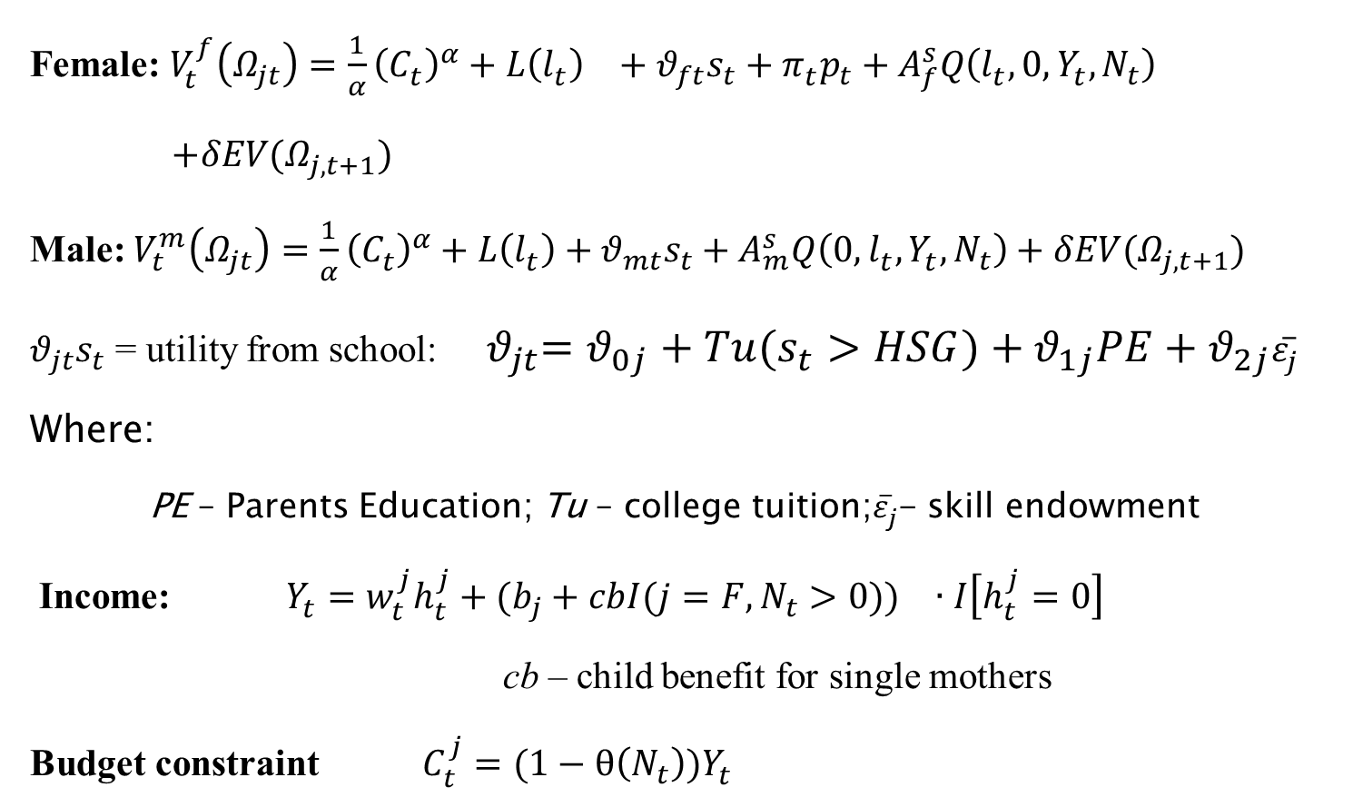
Value functions for singles
Female: $V_{t}^{f}\left(Ω_{jt}\right)=\frac{1}{α}{\left(C_{t}^{}\right)}^{α}+L{\left(l_{t}^{}\right)}^{}+{θ_{ft}s}_{t}+π_{t}^{}p_{t}+A_{f}^{s}Q\left(l_{t}^{},0, Y_{t}^{},N_{t}\right)$
$+δEV(Ω_{j,t+1})$
Male: $V_{t}^{m}\left(Ω_{jt}\right)=\frac{1}{α}{\left(C_{t}^{}\right)}^{α}+L\left(l_{t}^{}\right)+{θ_{mt}s}_{t}+A_{m}^{s}Q\left(0,l_{t}^{}, Y_{t}^{},N_{t}\right)+δEV(Ω_{j,t+1})$
${θ_{jt}s}_{t}$ = utility from school: ${ θ}_{jt}=θ_{0j}+Tu(s_{t}>HSG)+θ_{1j}PE+θ_{2j}{\overline{ε}}_{j}^{}$
Where:
PE – Parents Education; Tu – college tuition;${\overline{ε}}_{j}^{}$- skill endowment
Income: $Y_{t}^{}=w_{t}^{j}h_{t}^{j}+({b_{j}+cbI({j=F,N}_{t}>0))}_{}∙I\left[h_{t}^{j}=0\right]$
cb – child benefit for single mothers
Budget constraint $C_{t}^{j}=(1−θ\left(N_{t}\right))Y_{t}^{}$

Slide 25
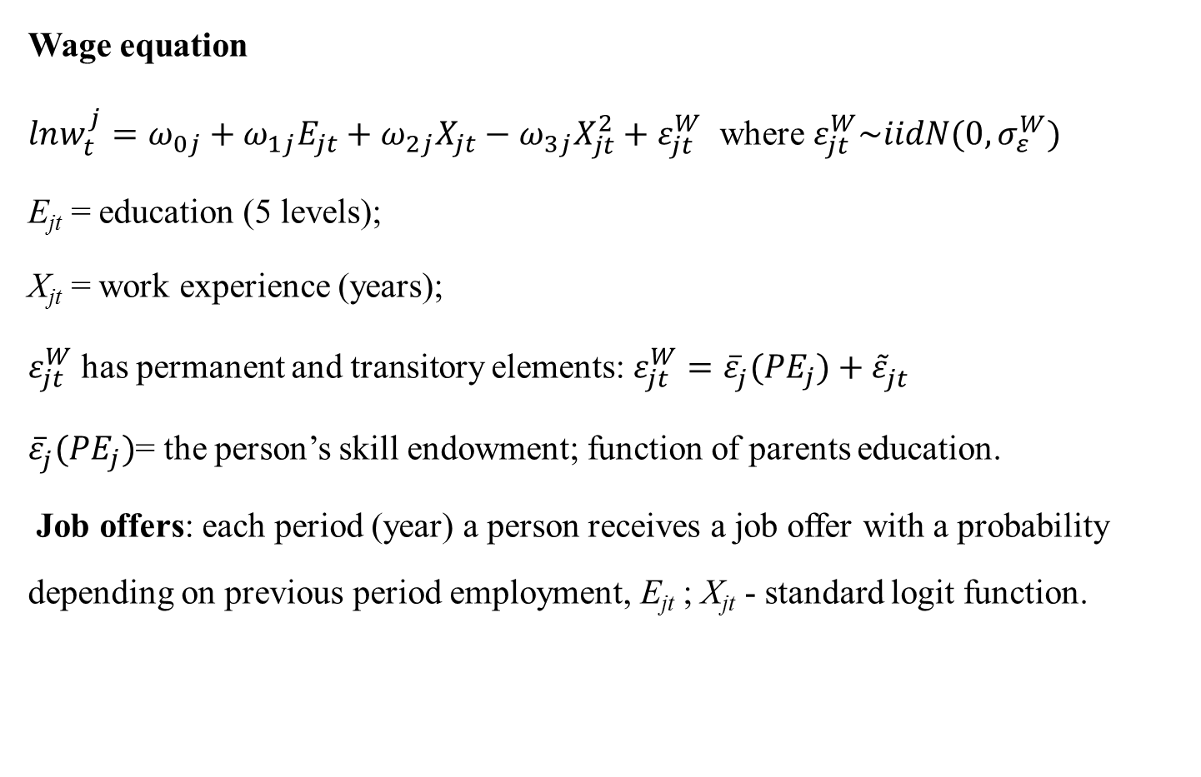
Labor market
Wage equation
$lnw_{t}^{j}=ω_{0j}+ω_{1j}E_{jt}+ω_{2j}X_{jt}−ω_{3j}X_{jt}^{2}+ε_{jt}^{W}$ where $ε_{jt}^{W}\sim iidN(0,σ_{ε}^{W})$
E_{jt} = education (5 levels);
X_{jt} = work experience (years);
$ε_{jt}^{W}$ has permanent and transitory elements: $ε_{jt}^{W}={\overline{ε}}_{j}^{}({PE}_{j})+{\tilde{ε}}_{jt}^{}$
${\overline{ε}}_{j}^{}({PE}_{j})$= the person’s skill endowment; function of parents education.
Job offers: each period (year) a person receives a job offer with a probability depending on previous period employment, E_{jt} ; X_{jt} - standard logit function.

Slide 26
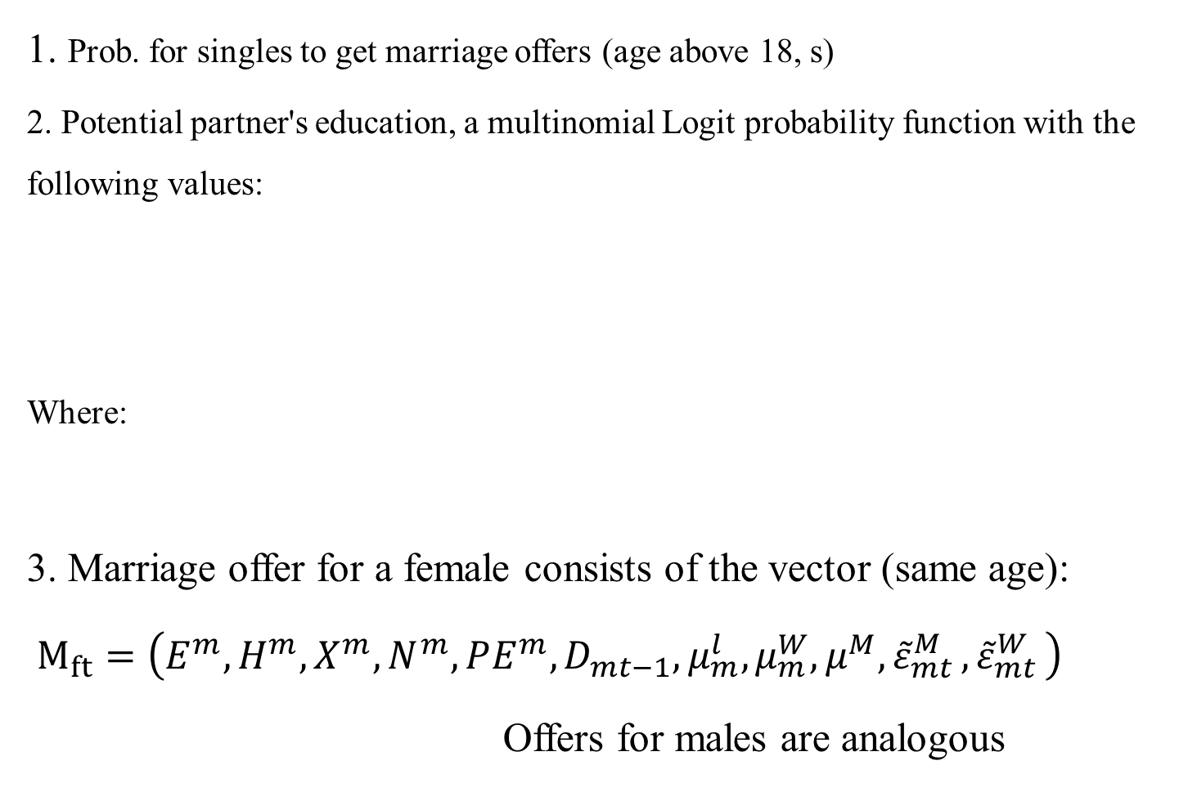
Marriage market
1. Prob. for singles to get marriage offers (age above 18, s)
2. Potential partner's education, a multinomial Logit probability function with the following values:
Where:
3. Marriage offer for a female consists of the vector (same age):
$M_{ft}=\left(E_{}^{m},H^{m},X^{m},N^{m},PE_{}^{m},D_{mt−1},μ_{m}^{l}, μ_{m}^{W},μ_{}^{M}{, \tilde{ε}}_{mt}^{M}{, \tilde{ε}}_{mt}^{W}\right)$
Offers for males are analogous

Slide 27
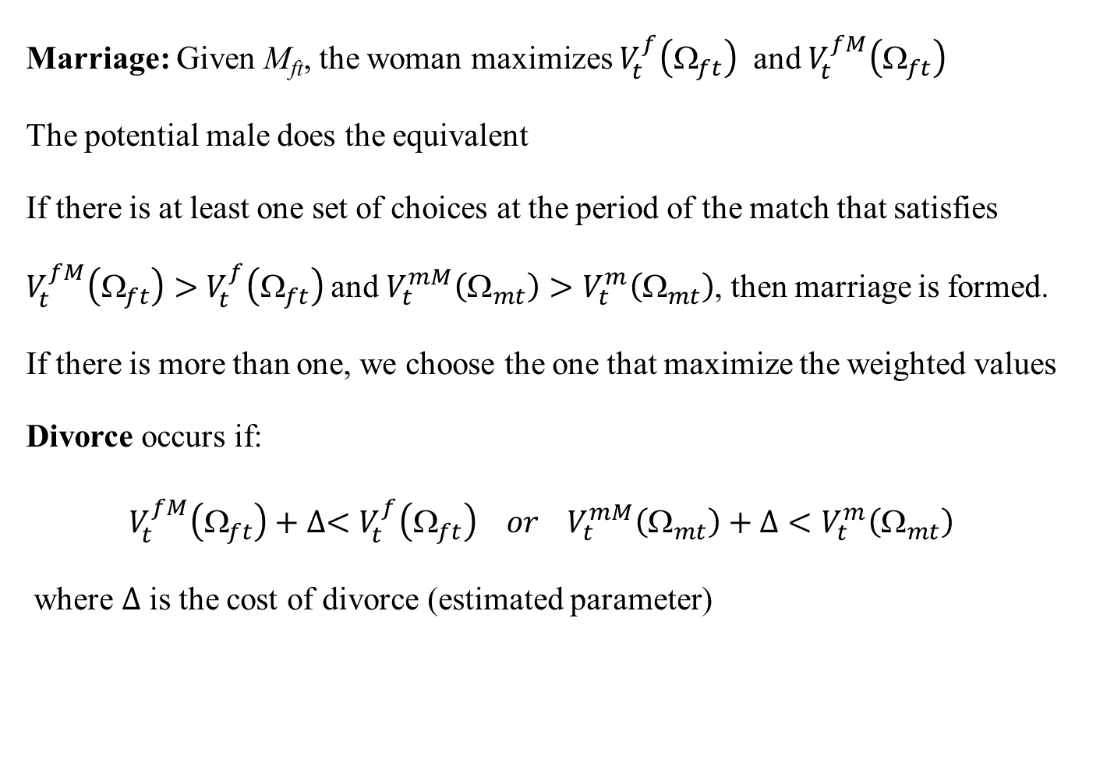
Marriage decision problem
Marriage: Given M_{ft}, the woman maximizes $V_{t}^{f}\left(Ω_{ft}\right)$ and $V_{t}^{fM}\left(Ω_{ft}\right)$
The potential male does the equivalent
If there is at least one set of choices at the period of the match that satisfies $V_{t}^{fM}\left(Ω_{ft}\right)>$ $V_{t}^{f}\left(Ω_{ft}\right)$and $V_{t}^{mM}\left(Ω_{mt}\right)>V_{t}^{m}\left(Ω_{mt}\right)$, then marriage is formed.
If there is more than one, we choose the one that maximize the weighted values
Divorce occurs if:
$V_{t}^{fM}\left(Ω_{ft}\right)+∆<V_{t}^{f}\left(Ω_{ft}\right) or V_{t}^{mM}\left(Ω_{mt}\right)+Δ<V_{t}^{m}\left(Ω_{mt}\right)$
where $∆$ is the cost of divorce (estimated parameter)

Slide 28
Estimation
Estimate by simulated GMM.
CPS data (moments) of the cohort of 1955 (1953-1957).
CPS cohort of 1975 (1973-1977) for counterfactuals.

Slide 29
Moments
moment | # of moments
Men Employment | 43*
Women Employment | 43
Married Women Employment | 43
Unmarried Women Employment | 43
Married with Children Women Employment | 43
Married no Children Women Employment | 43
Unmarried with Children Women Employment | 43
Unmarried no Children Women Employment | 43
Men Schooling Distribution – 5 groups | 5 X 15**
Women Schooling Distribution – 5 groups | 5 X 15**
Marriage Rate | 43
Women # of Children by Age | 25***
Married Women # of Children by Age | 25***
Women Wage | 43
Married Women Wage | 43
Unmarried Women Wage | 43
Men Wage | 43
Assortative Mating | 5 X 5
Wage by education level – women only | 5 X 43
Employment by education level – women only | 5 X 43
Women Health distribution | 3 X 43
Men Health distribution | 3 X 43
Total | 1472****
Notes:
*most moment starts at age 16 and end at 58, 43 periods (the 1955 cohort is 58 years old today)
** Schooling distribution from age 16 to 30, no schooling after 30.
*** from age 16 to 40. No newborn after 40.
**** 116 parameters in dynamic model, 84 in static model (the difference is the terminal value parameters)

Slide 30
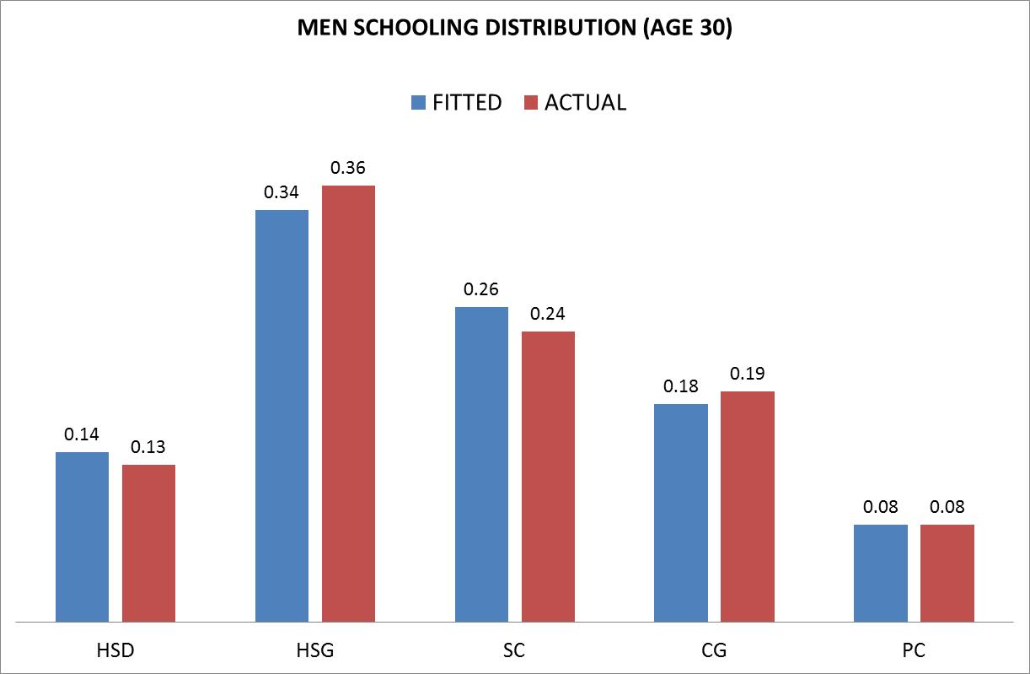
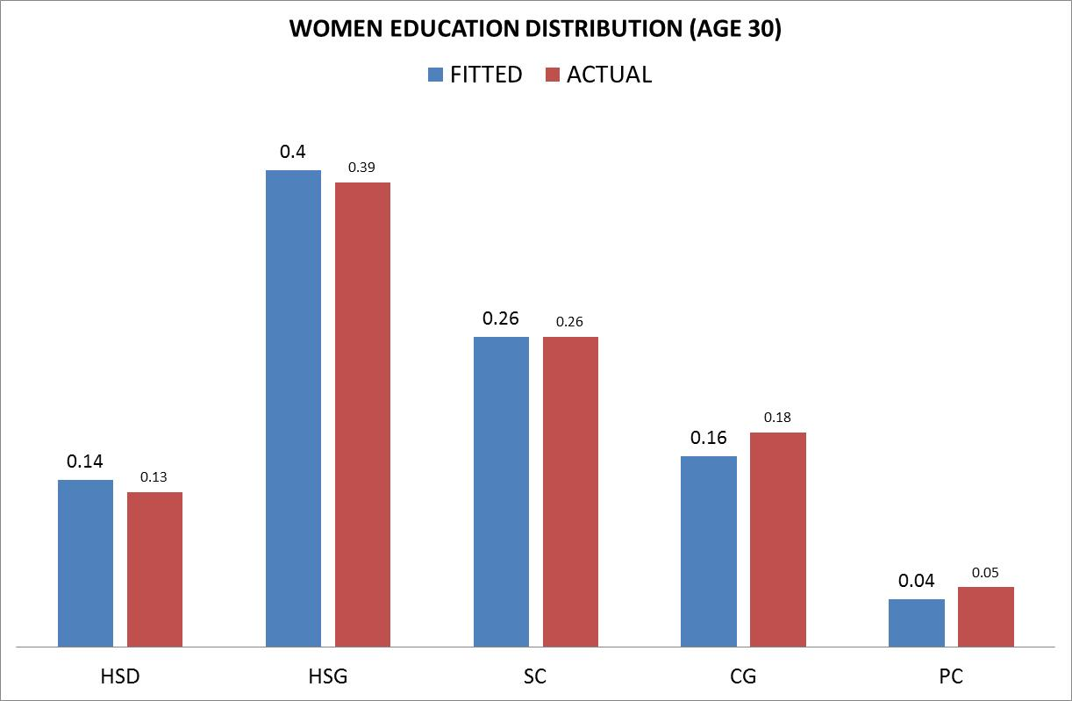
1955 Education Distribution

Slide 31
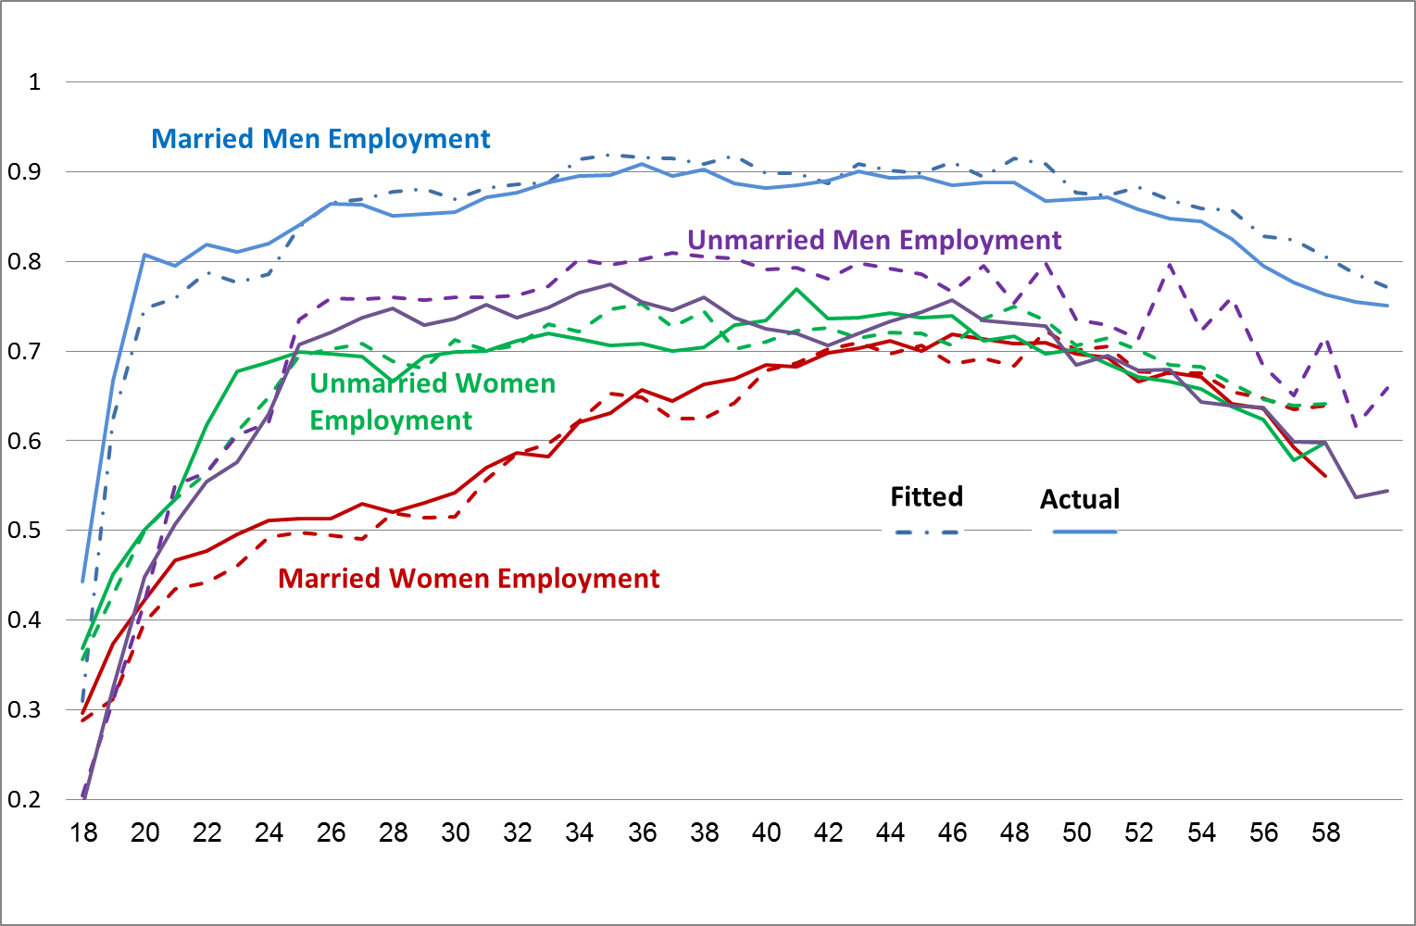
1955 Employment
Good Fit for both Men and Women, Between 25-40 Married Women work less than Unmarried

Slide 32
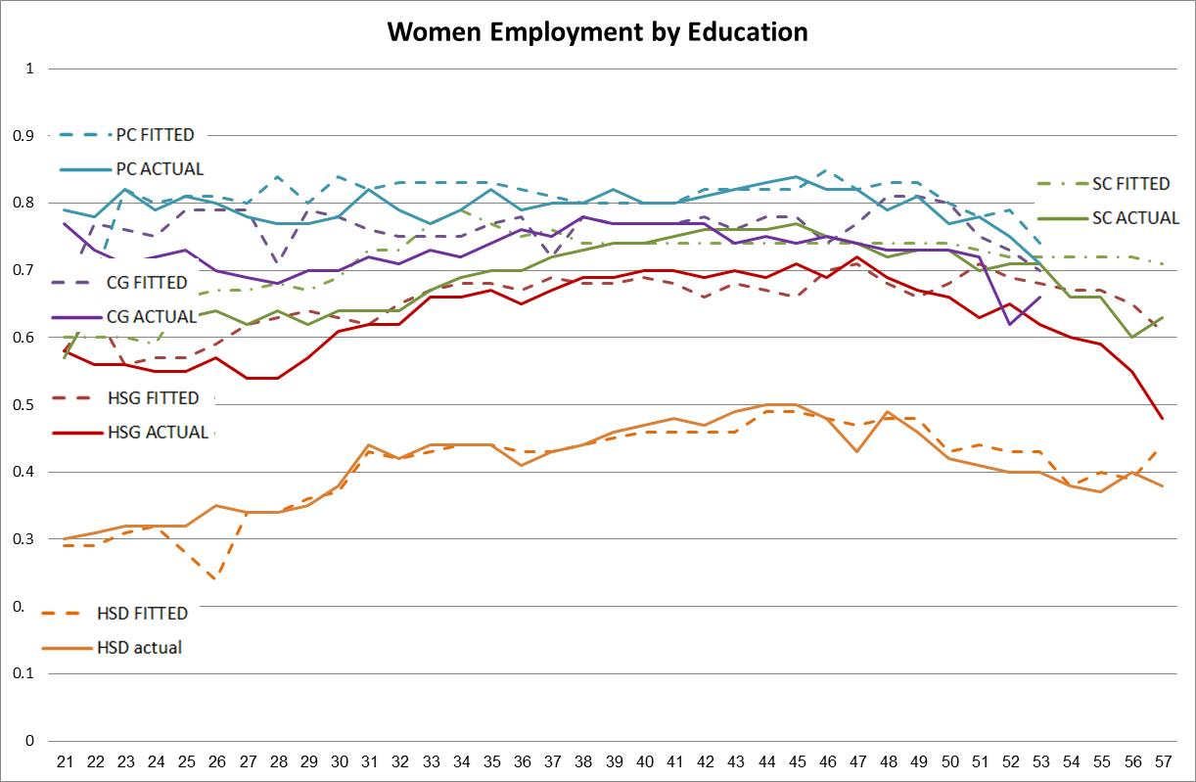
1955 Women’s Employment by Education
Good Fit by 5 education groups

Slide 33
1955 Assortative Mating
Good fit both on homogenous marriages (diagonal) and not

Slide 34
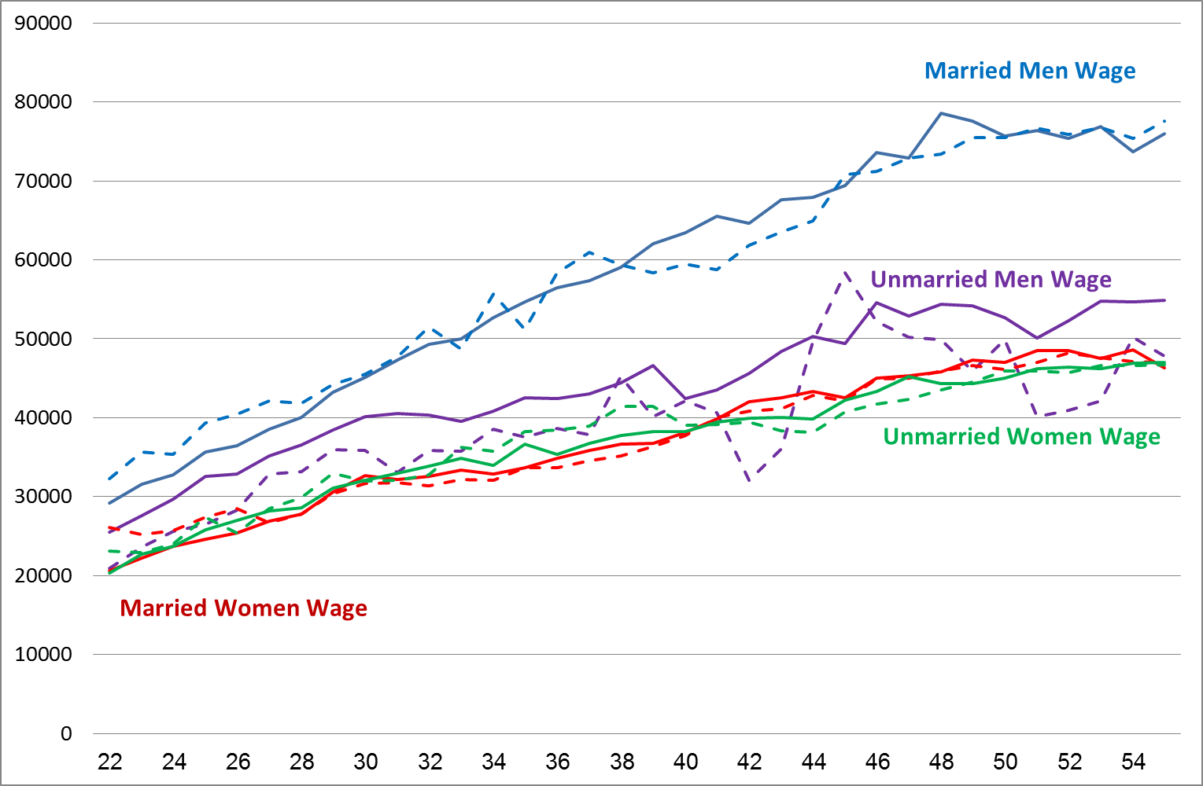
1955 Wages
Good Fit for both men and women. Negative selection for men. No selection for women.

Slide 35
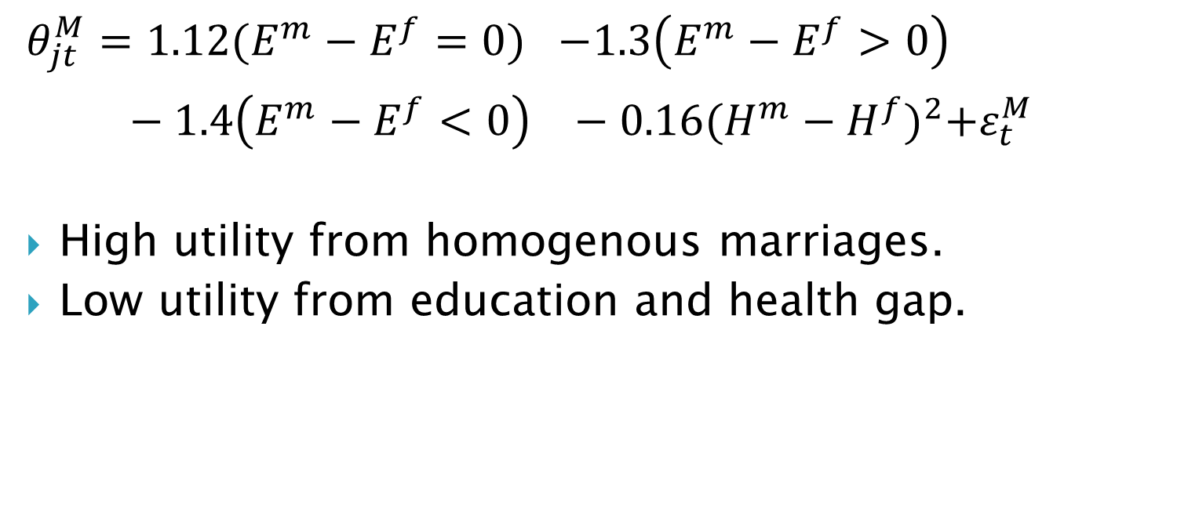
Marriage Taste Parameters
$$θ_{jt}^{M}=1.12{(E^{m}−E^{f}=0)}^{}−1.3\left(E^{m}−E^{f}>0\right)−1.4{\left(E^{m}−E^{f}<0\right)}^{}−0.16{(H^{m}−H^{f})}^{2}+ε_{t}^{M}$$
High utility from homogenous marriages.
Low utility from education and health gap.

Slide 36
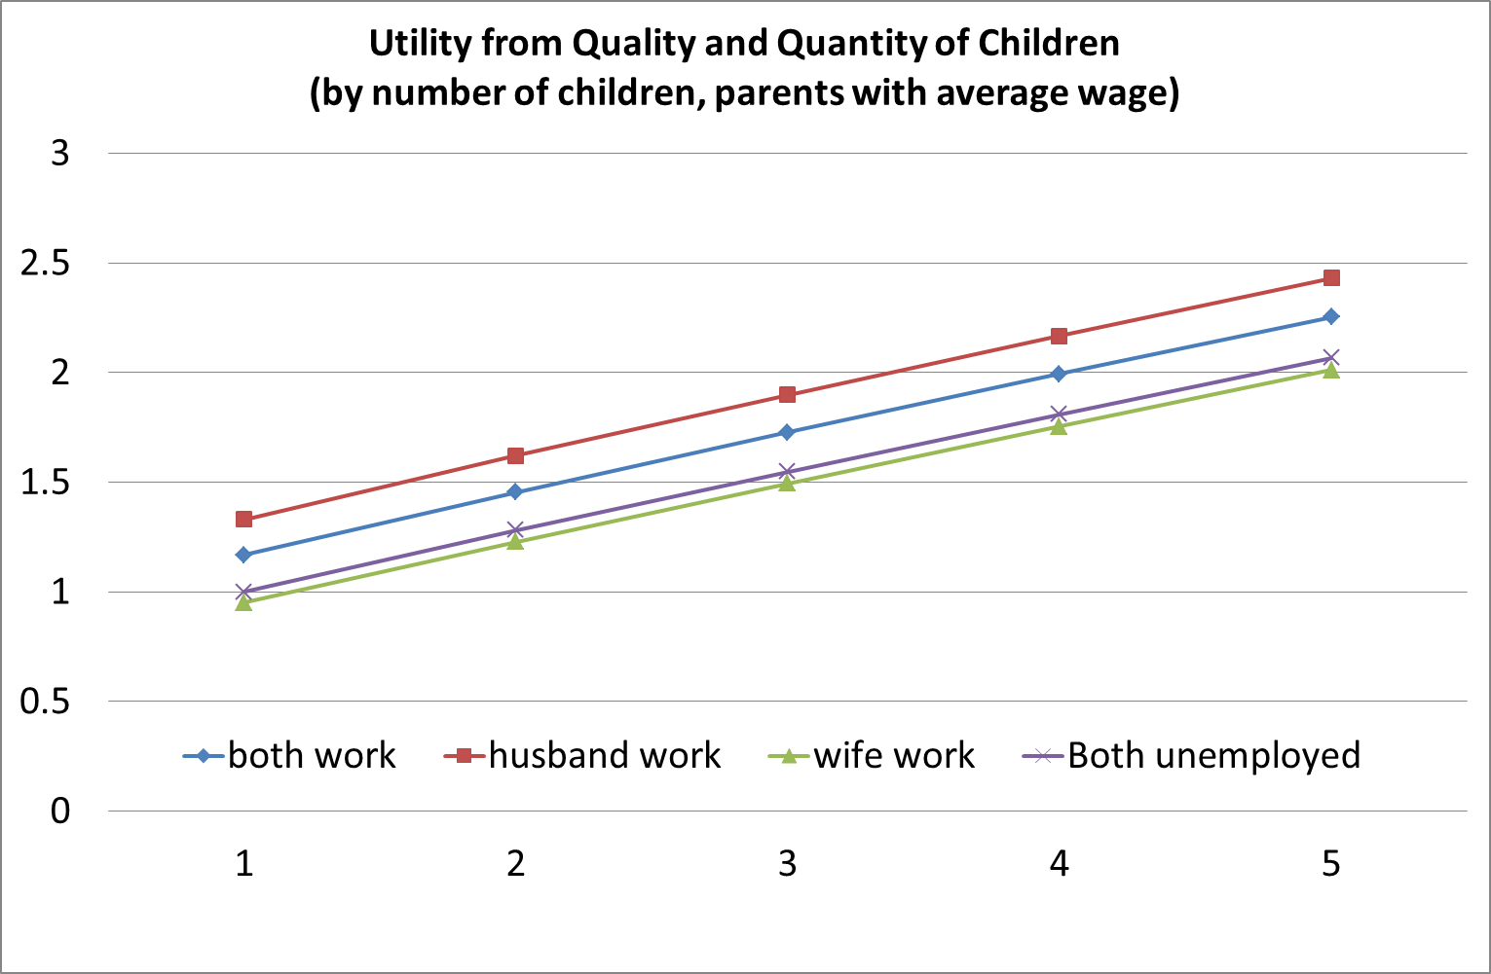

Children’s utility Parameters higher utility when both unemployed than only wife is working
$$\text{Q}\left(l_{t}^{f},l_{t}^{m}, Y_{t}^{M},N_{t}\right)={\left(.28{\left(l_{t}^{f}\right)}^{−.85}+.43{\left(l_{t}^{m}\right)}^{−.85}+.0002{\left(θ\left(1\right)Y_{t}^{M}\right)}^{−.85}+(.29)N_{t}^{ρ}\right)}^{1/−.85}$$

Slide 37

Utility from School Parameters
$θ_{jt}=θ_{0j}+Tu(s_{t}>HSG)+θ_{1j}PE+θ_{2j}{\overline{ε}}_{j}^{}$
Utility from HS always positive.
Utility from College always negative (cost of tuition)
Individuals go to college only for future gains.

Slide 38
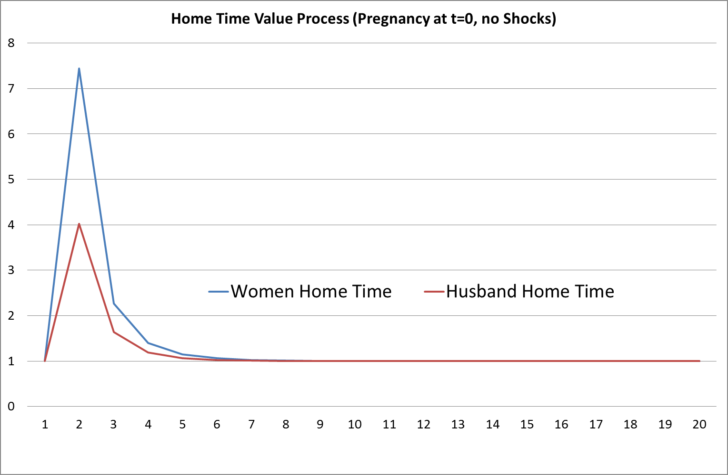

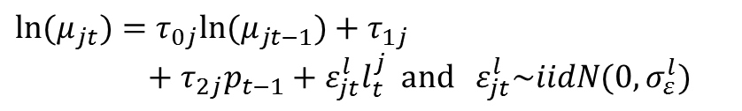
Leisure (Home) Value Parameters
L$\left(l_{t}^{j}\right)=\frac{β_{jt}}{γ}{\left(l_{t}^{j}\right)}^{γ}+μ_{jt}l_{t}^{j}$ $β_{jt}$= $β_{j1}\text{E}\text{jt}$+ $β_{j2}\text{H}\text{jt}$+ $β_{j3}\text{P}\text{t}$
Female: $β_{ft}$= $0.01\text{E}\text{jt}$+ $0.026\text{H}\text{jt}$+ $0.059\text{P}\text{t}$
Male: $β_{mt}$= $0.00\text{E}\text{jt}$+ $0.033\text{H}\text{jtt}$
$${ln⁡(μ}_{jt})=τ_{0j}{ln⁡(μ}_{jt−1})+τ_{1j}+τ_{2j}p_{t−1}+ε_{jt}^{l}l_{t}^{j} and ε_{jt}^{l}\sim iidN(0,σ_{ε}^{l}){}$$
Time since pregnancy

Slide 39
Marriage Premium Fit
Can the model reproduced the marriage premium of the 1955 cohort?
The marriage premium of the CPS data is: -1.1% (statistically insignificant).
We simulated women’s wage from the model and run the same regression and got: -1.4% and (statistically insignificant).

Slide 40
1975 Cohort Predictions
1955: Women’s marriage premium is zero both in data and model.
1975: Women’s marriage premium is 6.6% in data (positive selection).
Can the model predict the change of selection into marriage?

Slide 41
1975 Cohort Predictions
3 changes:
  Change Parents Education from 20% in 1955 to 27% in 1975 of college graduate parents.
  Decrease divorce cost by 78% to fit the marriage rate of 1975.
  Re-estimate male and female wage parameters within the model to fit 1975 (conditional on the above changes).

Slide 42
1975 Cohort Predictions
Negative
Selection
Main source of change: Divorced Cost +Wages
Positive
Selection

Slide 43
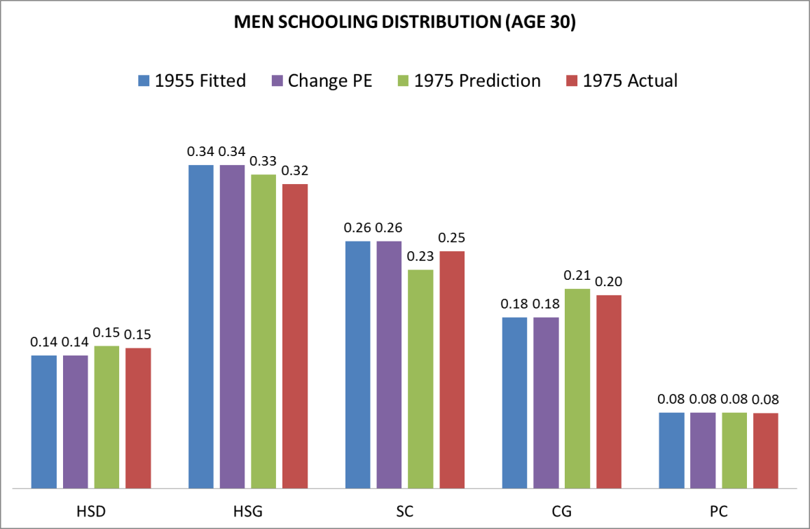
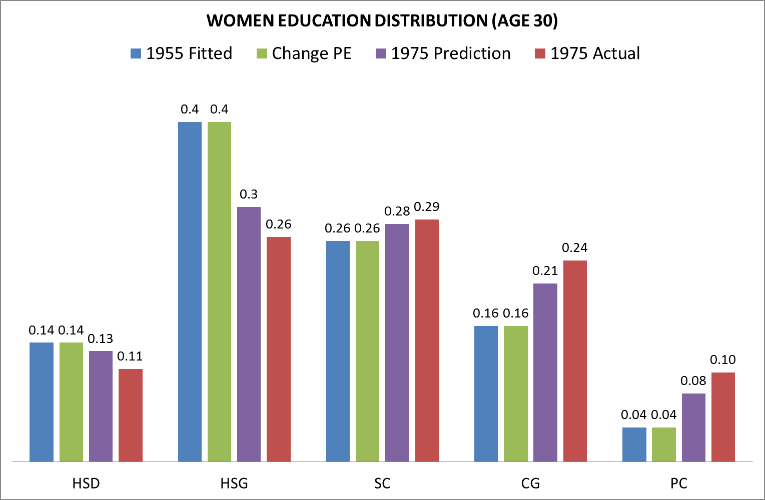
1975 Cohort Predictions

Slide 44
1975 Cohort predictions
The marriage premium of the CPS data is: 6.6% (statistically significant).
We simulated women’s wage from the 1975 Counterfactuals and got: 4.7% (statistically significant).

Slide 45
Thanks

