Slide 1
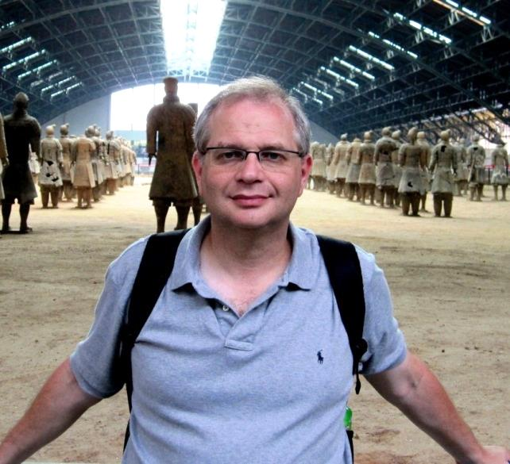
Graph Value for Cooperative Games
Ron Peretz (LSE)
Ziv Hellman (Bar Ilan)
Game Theory Seminar, Bar Ilan University, May 2014

Slide 2
(TU) Coalitional Games
$N$ players
$v:2^{N}→ℝ$, $v\left(∅\right)=0$.

Slide 3
Shapley value
${φ:Γ}_{N}→ℝ^{N}$, where $Γ_{N}=\left\{v:2^{N}→ℝ\text{, }v\left(∅\right)=0\right\}$.
Additivity
Null player
Efficiency
Symmetry
Implied: dummy, linearity, Monotonicity.

Slide 4
Spectrum value [Alvarez Hellman Winter (2013+)]
Admissible coalitions, intervals.

Slide 5
Graph value
Admissible coalitions: connected sets.
Shapley axioms + monotonicity.

Slide 6
Highlights
Graph values always exist and are not unique (generally).
On some graphs the value is unique.
Complete graph – Shapley value.
Line – Spectrum value is one of the graph values.
Cycle – unique but different from the Shapley value.
Linearity & Monotonicity are implied iff the graph value is unique.

Slide 7
Related literature
Myerson (77,80). Graphs and cooperation.
Dubey & Weber (77), Weber (88). Probabilistic values.
Bilbao & Edelman (2000). Convex geometries.
Alvarez Hellman Winter (2013+). Spectrum value.

Slide 8
Unrelated literature
Jackson (2005). Network games.
Forges & Serrano (2011). Incomplete information.

Slide 9
Coalitional games on a graph
$N$ players.
$G=\left\langle N,E\right\rangle$, connected graph.
$𝒜\left(G\right)=\left\{S⊂N connected\right\}$, admissible coalitions.
$𝒢=\left\{v:𝒜\left(G\right)→ℝ\right\}$, (TU) coalitional games over $G$.
$v,u∈𝒢$ are isomorphic if there is $π∈𝒜𝓊𝓉(G)$, such that $u=π∘v$, namely $u\left(S\right)=v\left(π^{−1}\left(S\right)\right), ∀S∈𝒜\left(G\right).$

Slide 10
Graph values
$φ:𝒢→ℝ^{N}$, an allocation rule (point solution concept) over $G$.
Additivity
Null player: $∀S∈𝒜(G) ∀i∈∂S, v\left(S\right)=v\left(S−i\right)⇒φ_{i}(v)=0$
Efficiency
Symmetry: isomorphic games yield isomorphic allocations. Formally, $φ∘π=π∘φ, ∀π∈𝒜𝓊𝓉(G).$
Monotonicity: $\left(S⊂T→v(S)≤v(T)\right)⇒φ\left(v\right)≥0$.

Slide 11
Existence [Edelman & Bilbao (2000)]
A chain is a total ordering of the players $≺$, such that $\{≺i\}≔\left\{j∈N:j≺i\right\}∈𝒜\left(G\right), ∀i∈N.$
$𝒞(G)$, all chains on $G$.
$φ_{i}\left(v\right)=$ $\frac{1}{|𝒞\left(G\right)|}\sum_{≺∈𝒞(G)}{v\left(≼i\right)−v\left(≺i\right)}, i∈N.$

Slide 12
Characterization
$𝒜𝓊𝓉(G)$ acts on $𝒞(G)$.
Theorem 1. The set of graph values over $G$ is given by $\{φ: μ∈Δ(𝒞(G)) 𝒜𝓊𝓉(G)\text{−}\text{invariant}\text{,}$ $φ_{i}\left(v\right)=\int{\left[v\left(≼i\right)−v\left(≺i\right)\right]dμ(≺)} ∀i∈N\}.$

Slide 13
Examples
$G=K_{n}$ (the complete graph), there is a unique invariant measure, the uniform distribution; the unique value is the Shapley value.
$G=L_{n}$ (line), there are many values one of which is the Spectrum value [Alvarez et al. 2013+].
$G=S_{n+1}$ (star), simple majority; centre gets 0.

Slide 14
Uniqueness
$G=K_{n}$, the action of $𝒜𝓊𝓉(G)$ on $𝒞(G)$ is transitive; hence there is a unique invariant measure; hence a unique value.
$G≠K_{n}$, the action of $𝒜𝓊𝓉(G)$ on $𝒞(G)$ is not transitive; hence there are many invariant measures…
Nevertheless, the value may be unique.
$G=C_{n}$ ($n$-cycle).

Slide 15
Uniqueness and implied properties
Theorem 2. If $G$ is a graph on which there is a unique value that satisfying the Shapley axioms + monotonicity, then there is a unique value satisfying the Shapley axioms (monotonicity is implied).
Theorem 3. If $G$ is a graph on which there is more than one value satisfying the Shapley axioms + monotonicity, then there is a value satisfying the Shapley axioms + linearity but not monotonicity, and a value satisfying the Shapley axioms but not linearity.
Theorem 4. The complete graph $K_{n}$ and the cycle $C_{n}$ are the only graphs on with the graph value is unique.

Slide 16
Proof outlines – Theorem 1
Following Weber (‘88), axioms are introduced gradually.
Linearity. $\left\langle φ\left(𝕀_{S}\right), S∈𝒜(G)\right\rangle$ determine $φ$. $φ_{i}\left(v\right)=\sum_{S∈𝒜(G)}{φ_{i}\left(𝕀_{S}\right)⋅v\left(S\right)}$

Slide 17
Linearity + Null player
$\left\langle φ_{i}\left(𝕀_{S}\right), i∈∂S\right\rangle$ determine $φ$. $φ_{i}\left(v\right)=\sum_{\begin{aligned}S: \\ i∈∂S\end{aligned}}{φ_{i}\left(𝕀_{S}\right)[v\left(S\right)−v(S∖\{i\})]}$
$$1$$
$$12$$
$$123$$
$$φ_{3}\left(𝕀_{23}\right)$$
$$2$$
$$23$$
$$234$$
$$∅$$
$$1234$$
$$3$$
$$34$$
$$341$$
$$4$$
$$41$$
$$412$$

Slide 18
Linearity + Dummy
Signed probabilistic value.
$$φ_{i}\left(v\right)=\sum_{\begin{aligned}S: \\ i∈∂S\end{aligned}}{φ_{i}\left(𝕀_{S}\right)[v\left(S\right)−v(S∖\{i\})]},$$
Where $\sum_{\begin{aligned}S: \\ i∈∂S\end{aligned}}{φ_{i}\left(𝕀_{S}\right)}=1.$

Slide 19
Linearity + Dummy + Monotonicity
Probabilistic value.
$$φ_{i}\left(v\right)=\sum_{\begin{aligned}S: \\ i∈∂S\end{aligned}}{φ_{i}\left(𝕀_{S}\right)[v\left(S\right)−v(S∖\{i\})]},$$
Where $\sum_{\begin{aligned}S: \\ i∈∂S\end{aligned}}{φ_{i}\left(𝕀_{S}\right)}=1$, $φ_{i}\left(𝕀_{S}\right)≥0$.

Slide 20
Linearity + Null player + Efficiency
Implies Dummy.
Signed 1-flow
$$∀S∈𝒜\left(G\right)∖\left\{∅,N\right\} \sum_{\begin{aligned}i: \\ i∈∂S\end{aligned}}{φ_{i}\left(𝕀_{S}\right)}=\sum_{\begin{aligned}j: \\ S∪\left\{j\right\}∈𝒜(G)\end{aligned}}{φ_{j}\left(𝕀_{S∪\{j\}}\right)},$$
$$\sum_{\begin{aligned}i: \\ i∈∂N\end{aligned}}{φ_{i}\left(𝕀_{N}\right)}=1.$$

Slide 21
Linearity + Null player + Efficiency
Signed random-order value.
$$φ_{i}\left(v\right)=\int{\left[v\left(≼i\right)−v\left(≺i\right)\right]dμ(≺)},$$
where $μ$ is a singed measure on $𝒞(G)$, $μ\left(𝒞\left(G\right)\right)=1$.
+ Monotonicity: random-order value. I.e., $μ∈Δ\left(𝒞\left(G\right)\right).$
+ symmetry: $μ$ must be $𝒜𝓊𝓉(G)$-invariant.

Slide 22
Theorem 4 – proof outlines
If the value on $G$ is unique, then
$G$ is transitive,
the complement of any connected vertex set is connected (Property C).
The cycle and the complete graph are the only graphs satisfying Property C.

Slide 23
Proof of Theorem 4 – step 1
A transitive graph that does not satisfy Property C has multiple values.
Path 1: $⨀⨀⨀⨀⨀⨀⨀$
Path 2: $⨀⨀⨀⨀⨀⨀$–$⨀$
$$v=𝕀_{N}+𝕀_{N∖⨀}$$
value $⨀$ =?

Slide 24
Proof of Theorem 4 – step 2
Lemma. The cycle and the complete graph are the only graphs satisfying Property C.
Max degree

Slide 25
Future research
What are the graphs on which the value is unique?
Solved! – complete graph and cycle.
Extensions to infinitely many players.
Infinite graphs.
Converging sequences of graphs,
Continuum of players (convex geometries).

Slide 26
Thank you!

